Slide 1
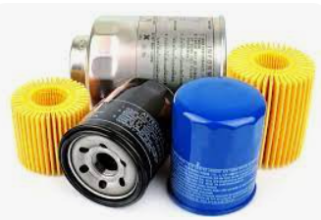
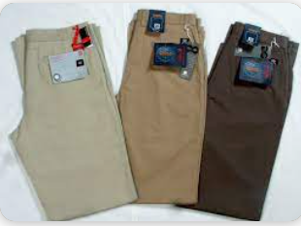
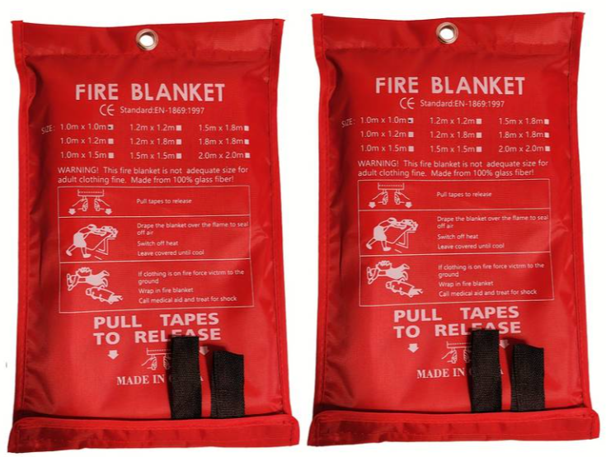
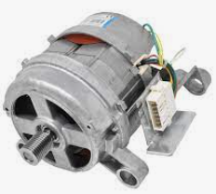
ACS Goods Description Quick Reference Guide
Examples:
Why a detailed Goods Description?
A compliant goods description is essential for efficient and timely processing of your shipment. Shipments with vague goods descriptions, such as ‘samples’, ‘parts’, can and will be held by customs. Customs mandate accurate, precise and non-generic goods descriptions - this on line item basis if shipment is destined or transiting EU.
“Nuts” is NOT compliant
“Aluminium bicycle nuts’ is compliant
“Spare parts or equipment” is NOT compliant
“Car oil filters” is compliant
“Garments, Textiles” is NOT compliant
“100% Cotton men’s trousers” is compliant
Advice on how to create a compliant goods description?
Remember to ask yourself 3 questions when detailing the goods description:
What are the goods?
What are they made of? Steel, Cotton, Plastic…
What are they used for or who will use them? Please note that in the case of clothing articles, the gender must be indicated or alternatively if it is for baby/child/unisex.
“Blankets” is NOT compliant
“Fire extinguishing blankets” is compliant
“Engine” is NOT compliant
“Washing machine engine’ is compliant
“Engine” is NOT compliant
“Washing machine engine” is compliant
“Foodstuff, Fruits” is NOT compliant
“Lemons’ is compliant
“Foodstuff or Fruits” is NOT compliant
“Lemons” is compliant

